Slide 1

Mastering Docker 101
From Zero to Hero
Fandi Gunawan
Senior Engineer
Teknologi Nasional Indonesia Siber
fandi dot septian at tnisiber dot id

Slide 2

https://s.id/container-arkavidia

Slide 3


Fandi Gunawan
Senior engineer specialized in creating cyber security solutions with secure architecture.
2018-now Senior Engineer Teknologi Nasional Indonesia Siber
2012-2017 Engineer NSS Focus
2008-2012 Engineer Oberthur Card Systems
Master degree in Information Technology – Universitas Indonesia
Bachelor degree in electrical Engineering – President University
fandigunawan

Slide 4
Prerequisite
Install Docker in your machine
or
Register to https://labs.play-with-docker.com/

Slide 5
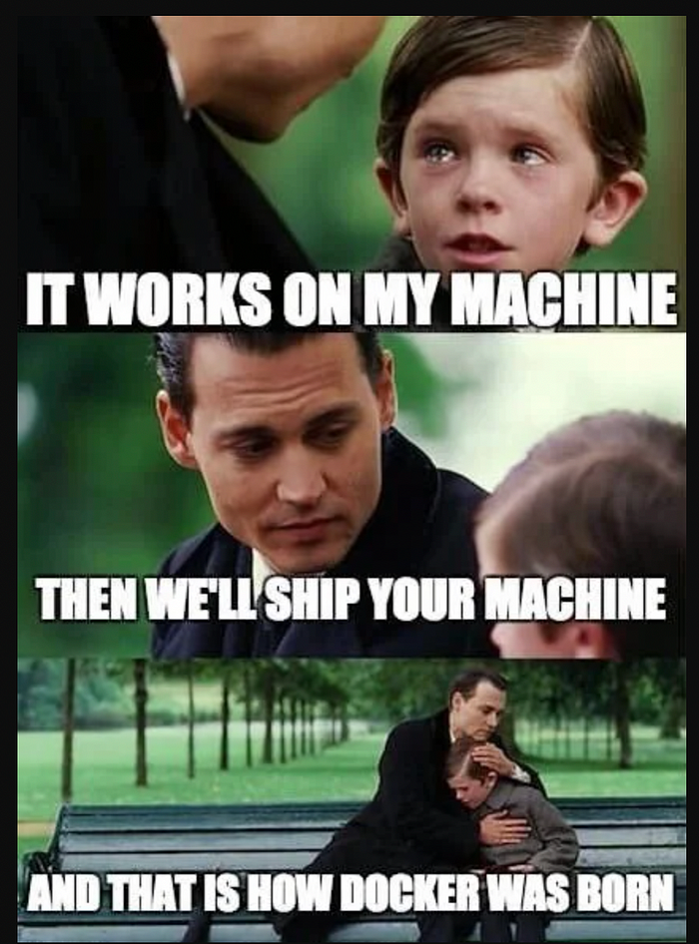
What is Docker?
Docker is an open-source platform for developing, shipping, and running applications in containers.
It allows developers to package applications with all dependencies into a standardized unit called a container.
Containers ensure consistency across different environments, from development to production.

Slide 6
Why Docker?
Portability
Runs the same way on any OS or cloud provider.
Scalability
Easily scales applications across multiple environments.
Efficiency
Uses fewer resources than traditional virtual machines.
Rapid Deployment
Enables faster development and testing cycles.

Slide 7
Key Components of Docker
Docker Engine
Core service that runs and manages containers.
Docker Images
Pre-built, reusable templates for containers.
Docker Containers
Lightweight, standalone execution environments.
Docker Hub and Registry
Public and private repository for container images.
Docker Compose
Tool for defining and running multi-container applications.

Slide 8
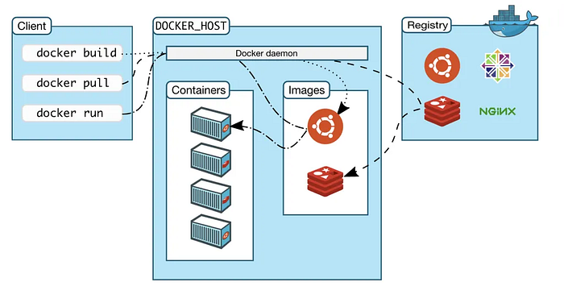
https://medium.com/@ravipatel.it/understanding-docker-architecture-a-comprehensive-guide-5ce9129df1a4

Slide 9
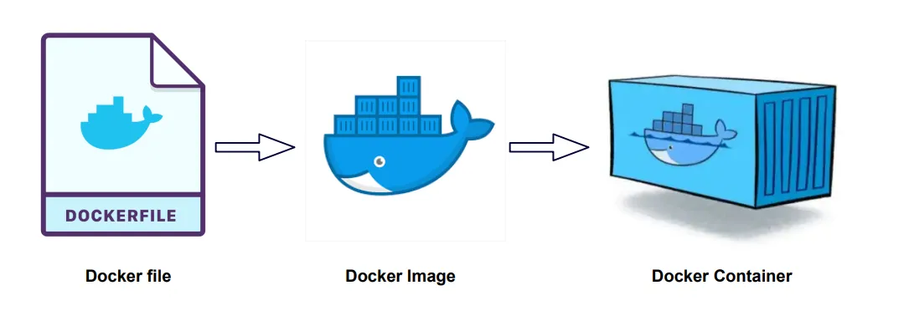
https://medium.com/@ravipatel.it/understanding-docker-architecture-a-comprehensive-guide-5ce9129df1a4

Slide 10
Docker vs Virtual Machines
Traditional Virtual Machines (VMs)
Run entire OS instances per application.
Heavy and resource-intensive.
Containers
Share the host OS kernel.
Lightweight, faster startup, and more efficient.

Slide 11
Docker vs Virtual Machines
Feature | Docker Containers | Virtual Machines
Performance | Lightweight & Fast | Heavy & Slow
OS Dependency | Shares Host OS | Runs a full OS per VM
Resource Usage | Uses fewer resources | Requires more RAM & CPU
Portability | Highly portable | Less portable

Slide 12
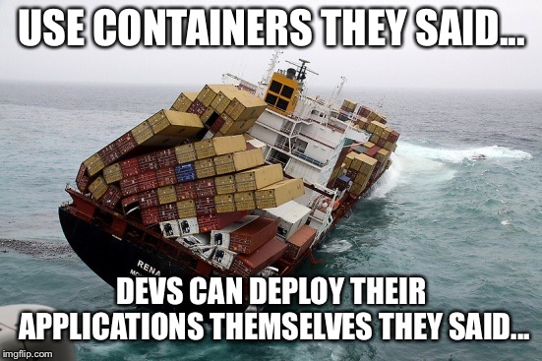
Docker in Modern Software Development
Microservices Architecture
Helps deploy and manage microservices efficiently.
Continuous Integration/Continuous Deployment (CI/CD)
Facilitates automated testing and deployment.
Cloud Computing
Integrates seamlessly with cloud services.
DevOps & Collaboration
Bridges the gap between development and operations teams.

Slide 13
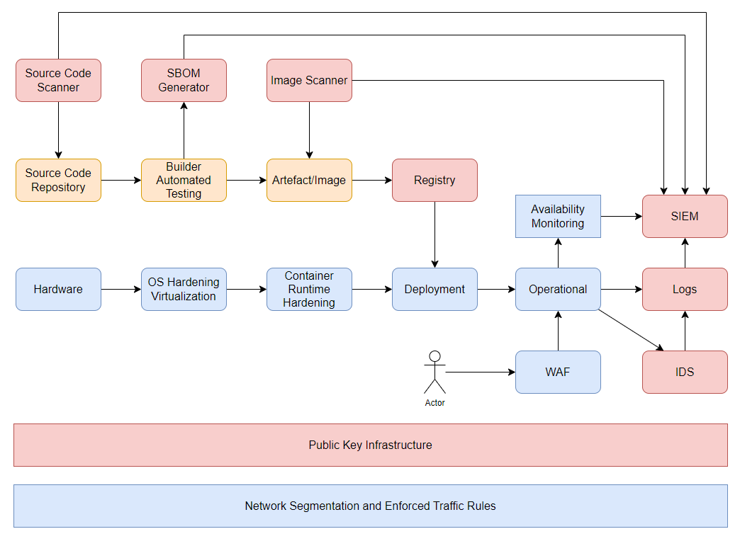

Slide 14
Introduction to Service Orchestration
Service Orchestration
Service orchestration is the automated configuration, coordination, and management of complex services, including containerized applications, across multiple nodes.
Importance
Essential for managing microservices-based applications, ensuring scalability, high availability, and automation.
Scope
Focus on containerized service orchestration, key tools, and differences from basic container management.

Slide 15
What is Containerized Service Orchestration?
Definition
A process that automates the deployment, scaling, networking, and availability of containerized applications.
Key Features
Automated deployment and scaling
Service discovery and load balancing
Self-healing capabilities
Declarative configuration management
Common Use Cases
Deploying microservices architectures
Managing cloud-native applications
Handling stateless and stateful workloads

Slide 16
Differences Between Container Management and Orchestration
Feature | Container Management | Container Orchestration
Scope | Single container lifecycle | Multi-container and service coordination
Scaling | Manual | Automated scaling based on demand
Networking | Basic networking setup | Advanced service discovery and load balancing
Fault Tolerance | Limited | Automated self-healing and rescheduling
Deployment | Manual or scripted | Declarative and automated deployment

Slide 17
Orchestration Tools – Docker Swarm vs. Kubernetes
Docker Swarm
Built-in clustering and orchestration for Docker
Simple setup and easy integration with Docker CLI
Limited in advanced networking and scaling features
Kubernetes
Industry-standard for container orchestration
Advanced scaling, self-healing, and rolling updates
Requires a more complex setup but offers greater flexibility

Slide 18
Why Orchestration is Important for Microservices
Scalability
Automatically scale services based on demand.
Fault Tolerance
Self-healing capabilities ensure application availability.
Service Discovery
Efficiently routes traffic between services without manual configuration.
Declarative Configuration
Use YAML or JSON files to define and maintain the desired system state.
CI/CD Integration
Enables automated deployments, rollbacks, and seamless updates.
Multi-Cloud & Hybrid Cloud
Portable and flexible deployments across different environments.

Slide 19
Introduction to Docker Swarm
What is Docker Swarm?
A native clustering and orchestration tool for Docker.
Enables containerized applications to run across multiple nodes.
Provides high availability and scalability for services.
Integrated with the Docker CLI and API.

Slide 20
Swarm vs Standalone Containers
Standalone Containers
Managed manually on a single host.
Require individual setup and scaling.
No built-in failover or service discovery.
Swarm Mode
Manages multiple containers across a cluster.
Built-in load balancing, service discovery, and rolling updates.
Automates container scheduling and scaling.

Slide 21
Docker Swarm Architecture
Manager Nodes
Handle cluster state, orchestration, and scheduling.
Worker Nodes
Execute tasks assigned by manager nodes.
Overlay Network
Enables communication between services.
Service Discovery
Ensures connectivity using internal DNS.

Slide 22
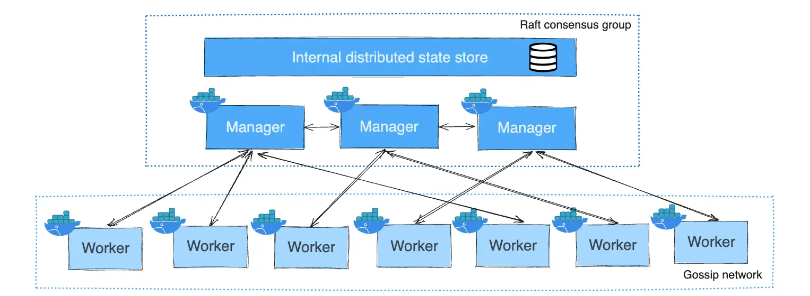
https://docs.docker.com/engine/swarm/how-swarm-mode-works/nodes/

Slide 23
Creating and Deploying Services in Swarm
Initialize Swarm
docker swarm init
Create a service
docker service create --name web -p 80:80 nginx
List services
docker service ls
Inspect service
docker service ps web
Update service
Rollback service
docker service update --image nginx:latest web
docker service rollback web

Slide 24
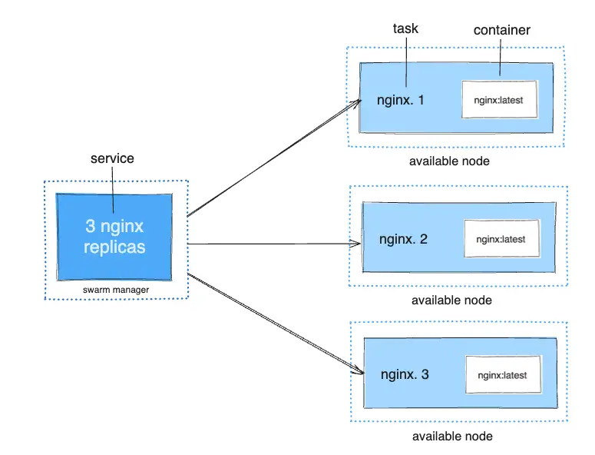
https://docs.docker.com/engine/swarm/how-swarm-mode-works/services/

Slide 25
Scaling Services in Swarm
Horizontal scaling is done using:
docker service scale web=5 (scales service to 5 replicas)
Automatic load balancing across replicas.
Rolling updates ensure zero downtime:
docker service update --image nginx:latest web
Self-healing mechanism: Restart failed containers automatically.

Slide 26
High Availability and Failover
Manager nodes use Raft Consensus Algorithm for state management.
Service replication ensures availability.
Nodes can be added or removed dynamically.
Auto-recovery of failed nodes or containers.

Slide 27
Docker Networking Overview
Docker networking enables communication between containers and external systems.
Provides various network drivers for different use cases.
Supports inter-container and external connectivity.

Slide 28
Docker Networking
Bridge Network
Default network mode for Docker.
Containers share a private internal network and communicate via IP.
Uses NAT for outbound traffic.
docker network create --driver bridge my_bridge.
Host Network
Removes network isolation, container shares host network stack.
No NAT, direct access to host network interfaces.
Faster but lacks container-level IP management.
docker run --network host my_container.
Overlay Network
Used in multi-host swarm environments.
Enables communication between containers on different hosts.
Uses VXLAN for encapsulation.
docker network create --driver overlay my_overlay.
Macvlan Network
Assigns containers their own MAC addresses on the physical network.
Provides better performance and direct network integration.
Useful for applications requiring unique IP addresses.
docker network create -d macvlan --subnet=192.168.1.0/24 my_macvlan.

Slide 29
Communication Between Containers
Containers in the same network can communicate using container names.
Use --link (deprecated) or user-defined networks.
DNS-based service discovery in overlay networks.
docker network connect my_network container1.

Slide 30
Persistent Storage - Volumes vs. Bind Mounts
Volumes
Managed by Docker, stored in /var/lib/docker/volumes/.
Portable across containers, better performance.
Created using docker volume create my_volume.
Bind Mounts
Directly map host directories into containers.
Provides direct access to host files, less portable.
docker run -v /host/path:/container/path my_container.

Slide 31
Storage in Multi-Container Environments
Volumes can be shared among multiple containers.
Docker Compose allows volume declaration for services.
Networked storage (NFS, CIFS) can be used for distributed environments.

Slide 32
docker-compose.yml example
version: '3'
services:
app:
image: my_app
volumes:
- my_shared_volume:/data
volumes:
my_shared_volume:

Slide 33
Monitoring Docker Containers
Essential for performance, resource usage, and issue detection.
Helps ensure containers run efficiently and reliably.
Multiple tools available for real-time and historical monitoring.

Slide 34
Docker Stats
Built-in tool for real-time container monitoring.
Provides CPU, memory, network, and I/O statistics.
Command
Lightweight but lacks historical data storage.
docker stats [container_name]

Slide 35
Prometheus for Monitoring
Time-series database optimized for container monitoring.
Scrapes metrics from containerized applications.
Uses exporters (e.g., cAdvisor, Node Exporter) to collect data.
Query data with PromQL for insights.

Slide 36
Grafana for Visualization
Works with Prometheus to create visual dashboards.
Supports multiple data sources and interactive charts.
Enables real-time container performance monitoring.
Custom alerts based on PromQL queries.

Slide 37
Health Checks and Alerts
Docker supports built-in health checks to monitor container state.
Define health checks in Dockerfile:
HEALTHCHECK --interval=30s --timeout=10s --retries=3 \
CMD curl -f http://localhost:8080 || exit 1
Use Prometheus Alertmanager for custom alert rules.

Slide 38
Logging in Docker
Essential for debugging, auditing, and monitoring.
Captures standard output and error streams.
Helps track container events and issues.
Multiple storage and forwarding options.

Slide 39
Docker Logs Command
View real-time container logs:
docker logs -f container_name
Supports filtering by timestamps and log levels.
Combine with grep or jq for advanced filtering.

Slide 40
Centralized Logging Solutions
ELK Stack (Elasticsearch, Logstash, Kibana)
Aggregates and analyzes container logs.
Logstash processes and enriches log data.
Fluentd
Lightweight log collector, integrates with multiple backends.
Parses and routes logs efficiently.
Loki (by Grafana)
Optimized for logging with Prometheus.
Uses labels instead of full indexing for better performance.

Slide 41
Docker Security Hardening
Minimize the Base Image
Use official and minimal images (e.g., alpine, distroless).
Avoid unnecessary tools or packages (e.g., curl, wget, bash).
Use multi-stage builds to keep the final image clean.
Use Non-Root Users
Do not run the application as root inside the container.
Add a user in Dockerfile:
RUN addgroup --system appgroup && adduser --system --ingroup appgroup appuser
USER appuser
Scan and Fix Vulnerabilities
Use security scanners like:
Trivy (trivy image myimage:latest)
Snyk (snyk test --docker myimage:latest)
Regularly update dependencies and base images.

Slide 42
Docker Security Hardening
Enable Read-Only Filesystem
Add --read-only flag when running containers:
docker run --read-only myimage
Reduce Attack Surface
Remove unnecessary binaries:
RUN rm -rf /var/cache/apk/* /tmp/*
Disable shell access by setting CMD ["myapp"] (not CMD ["sh"]).

Slide 43
CIS Docker Benchmark
The CIS Docker Benchmark is a security guideline provided by the Center for Internet Security (CIS) that includes best practices for configuring Docker securely.
Automate Security Auditing with docker-bench-security
The easiest way to check your Docker setup against CIS Benchmark is by using docker-bench-security.
Install and Run docker-bench-security
git clone https://github.com/docker/docker-bench-security.git
cd docker-bench-security
sudo ./docker-bench-security.sh

Slide 44
Practical Session

Slide 45
Understanding Docker Images and Dockerfiles
Docker images are lightweight, standalone, and executable software packages that include everything needed to run an application.
A Dockerfile is a script that contains a series of instructions to create a Docker image.
Building a Docker image from a Dockerfile ensures consistency and repeatability.

Slide 46
Basic Structure of Dockerfile
FROM
Specifies the base image.
RUN
Executes commands during the image build process.
COPY or ADD:
Adds files from the host system into the image.
WORKDIR
Sets the working directory.
CMD or ENTRYPOINT
Defines the command to run the container.
EXPOSE
Declares the port the container will listen on.

Slide 47
Dockerfile Python App
# Use official Python base image
FROM python:3.12-slim
# Set working directory
WORKDIR /app
# Copy application files
COPY . /app
# Install dependencies
RUN pip install --no-cache-dir -r requirements.txt
# Define default command
CMD ["python", "app.py"]

Slide 48
Dockerfile Static Website
# Use official Nginx base image
FROM nginx:latest
# Copy custom configuration file
COPY nginx.conf /etc/nginx/nginx.conf
# Copy website files
COPY ./html /usr/share/nginx/html
# Expose HTTP port
EXPOSE 80
# Start Nginx service
CMD ["nginx", "-g", "daemon off;"]

Slide 49
Dockerfile Static Website
# Use Node.js official base image
FROM node:20
# Set working directory
WORKDIR /usr/src/app
# Copy package files and install dependencies
COPY package*.json ./
RUN npm install
# Copy application source
COPY . .
# Expose application port
EXPOSE 3000
# Start the application
CMD ["node", "server.js"]

Slide 50
Build Image
Use the docker build command:
docker build -t myapp .
-t myapp: Assigns a tag (name) to the image.
. : Specifies the build context (current directory).
Use docker images to list created images.

Slide 51
Start Container
Start a container from an image:
docker run -d -p 8080:80 myapp
-d: Runs in detached mode.
-p 8080:80: Maps host port 8080 to container port 80.
List running containers:
docker ps
Stop and remove a container:
docker stop <container_id>
docker rm <container_id>

Slide 52
Building Image: Best Practices
Use lightweight base images (e.g., alpine versions).
Reduce the number of layers in a Dockerfile.
Use multi-stage builds for production images.
Remove unnecessary files and dependencies.
Leverage Docker caching by ordering commands efficiently.

Slide 53
Thankyou

